Slide 1
Intro to Counseling Techniques
Sam Prosser-USM Upward Bound

Slide 2
Who am I to tell you???
Currently pursuing a Master’s Degree in School Counseling from USM
Passed my CPCE (Counselor Preparation Comprehensive Examination)
Basically, I can start counseling any time

Slide 3
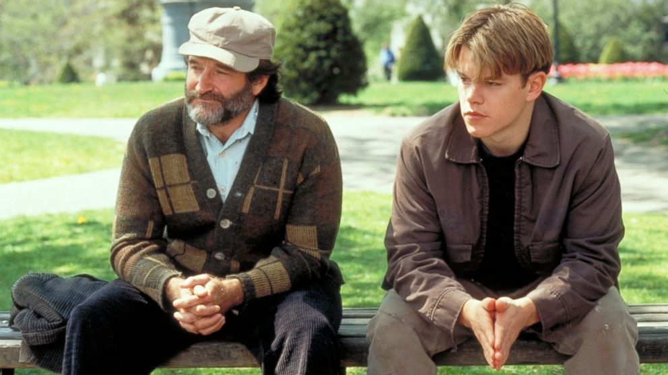
How do I get them talking?
Some students really need a few nudges to get talking. Here are a few techniques:
Draw or have some form of art available
Sit next to or at an angle instead of facing them
Invest in a sand tray
Notes:
Draw: breaks eye contact
Seat position: example Good Will Hunting

Slide 4
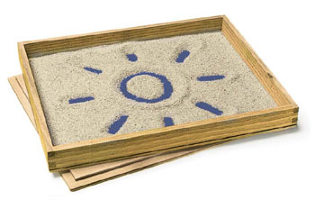
Sand Tray

Slide 5
The “Miracle Question”
This can really help students realize what goal they have
Can also help visualize the outcome
“Imagine that tonight when you fall asleep, the problem(s) that brought you in here gets magically fixed through a miracle. The only problem is, nobody told you this miracle occurred so you have to figure it out by yourself. What in your life looks different after this miracle occurred? How can you tell that everything is better?”

Slide 6
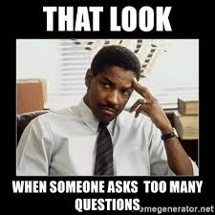
The Use of Questions
Be careful with how many questions you use
Open ended versus closed questions

Slide 7
Practice!
First partner talk for 5 minutes about a challenge you overcame
Second partner, do not ask ANY questions! You may use statements
Switch and repeat

Slide 8
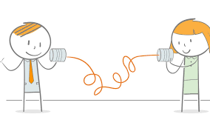
Listening Techniques
Think of a time when someone made you feel heard.
What did they do?
What did they say?
What did their body look like?

Slide 9
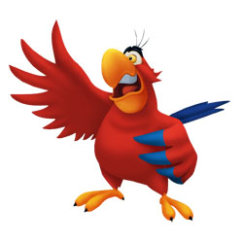
Find a Partner!
Practice: 3 minutes talking, 1 minute paraphrase
One partner talk about something you enjoy doing in your free time
Listening partner…paraphrase what you heard
Side note: it is okay if this feels like it is not genuine
Switch and repeat

Slide 10
Debrief
What felt comfortable?
What felt uncomfortable?

Slide 11
The Number 1 Tip:
Be genuine with your students…they have good radar

Slide 12
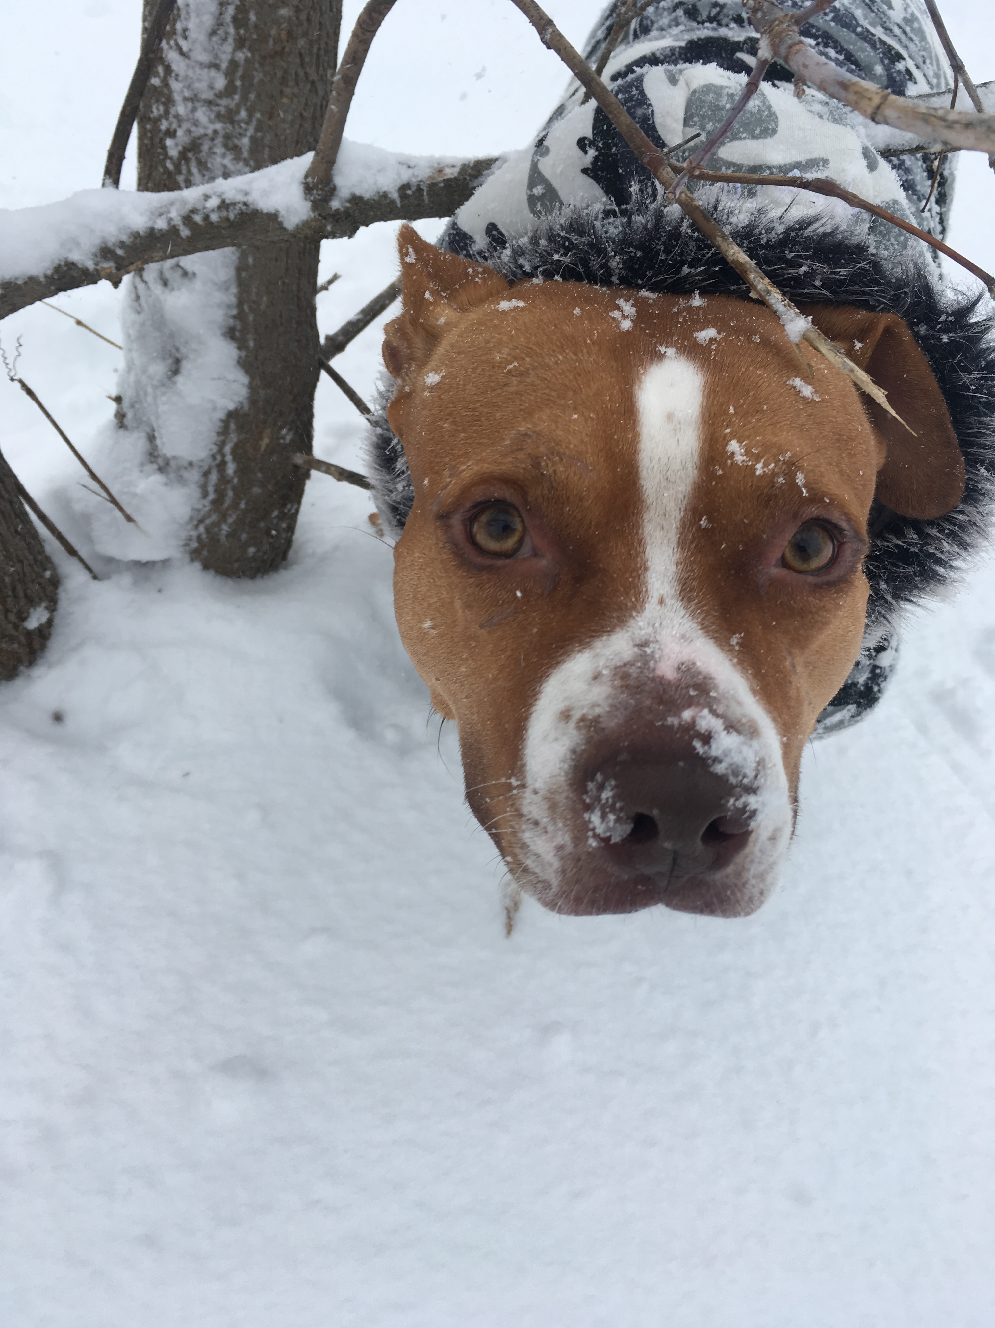
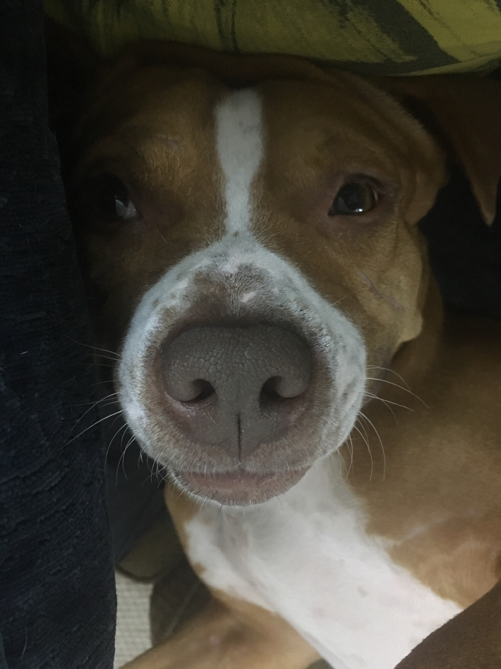
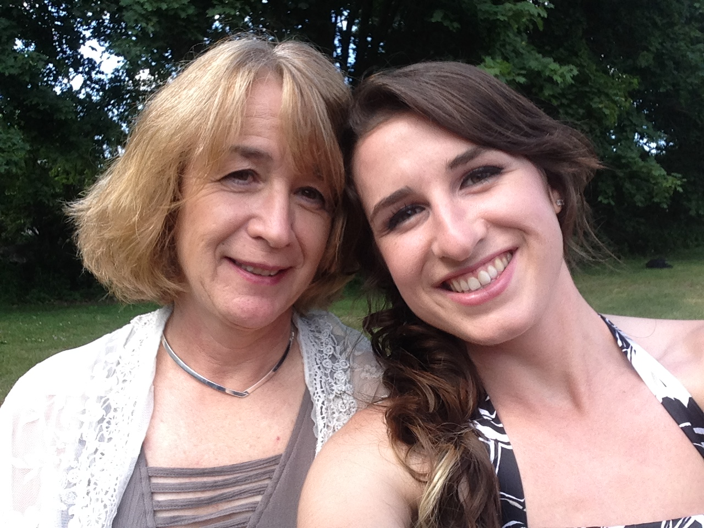
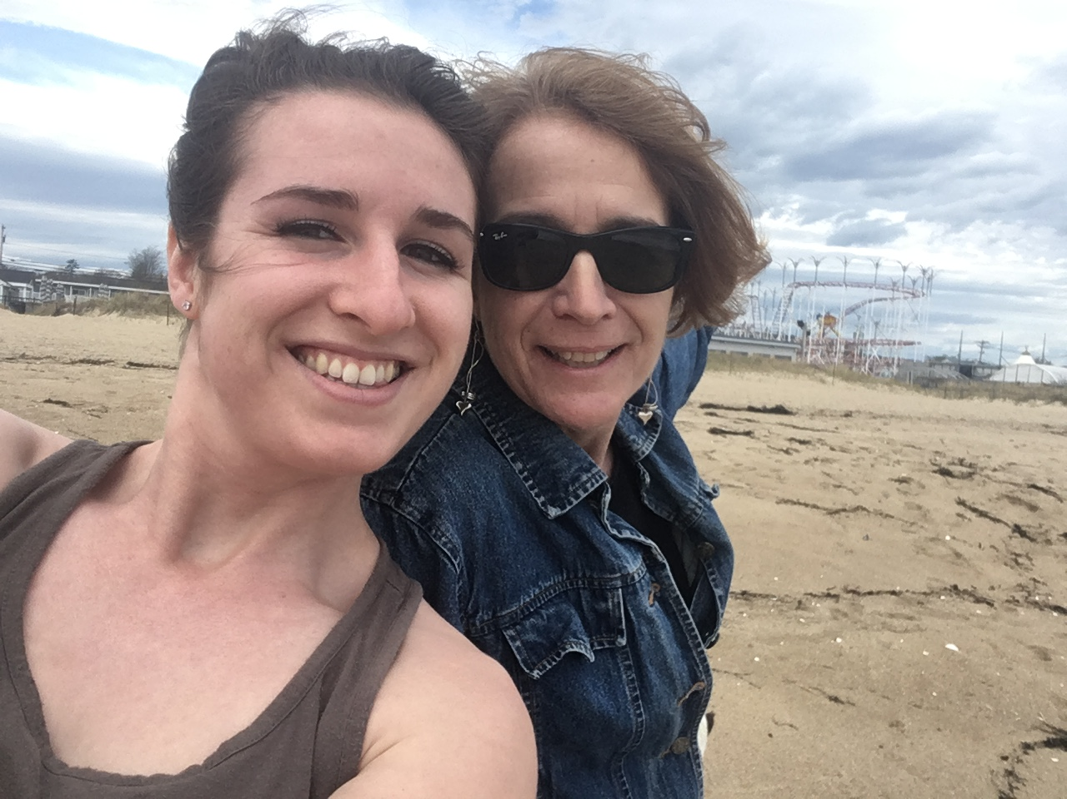
Homework
Go practice on your family, friends, and students!
I practice on my mom all the time (she doesn’t know that)
I also practice using statements instead of questions with my dog

Slide 13
Samantha.prosser@maine.edu

